Slide 1
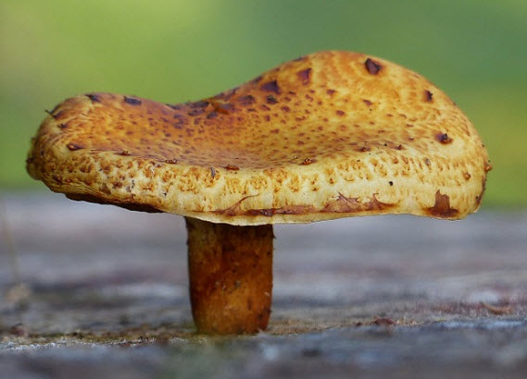
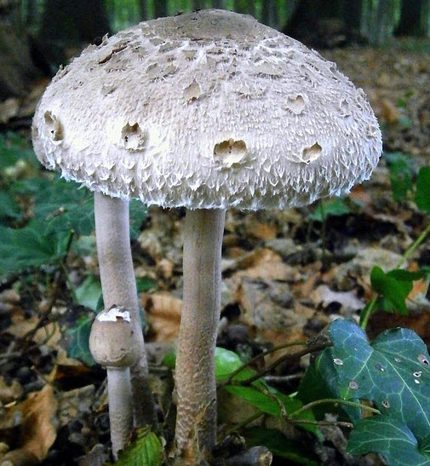
Solution 1: Mushrooms

Slide 2
Step 1: Coming Soon!

